Slide 1

ACCIDENT DETECTION AND ALERT SYSTEM
Project Guide :
Team Members:
Vignesh M (2020102169)
Vishwa K (2020102173)
Vijay R S (2020102320)
Mrs S. Selvi B.E.,M.E.,(Ph.D).,
Department of Computer Science & Engineering Second Review
Sethu Institute of Technology

Slide 2
CONTENTS
Abstract
Problem Identification
  Definition of the Problem
  Motivation for the problem
  Objectives of the Project Work
  Usefulness / Relevance to the Society
Literature Survey & Inference
System Design
List of Modules and Module Description
Hardware / Software requirements
Output and Results
References
Department of Computer Science & Engineering Second Review
Sethu Institute of Technology

Slide 3
ABSTRACT
This abstract introduces an IoT-based Accident Alert System designed to enhance road safety. Leveraging sensors embedded in vehicles and road infrastructure, the system detects potential accidents in real-time. Upon detection, it promptly alerts nearby vehicles and emergency services, reducing response time and mitigating the severity of accidents.
Utilizing advanced communication technologies, such as GPS and wireless networks, the system ensures swift and accurate transmission of alerts.
It offers features like automatic collision detection and vehicle tracking, enabling efficient post-accident assistance. By seamlessly integrating with existing infrastructure, this solution aims to significantly enhance road safety and minimize casualties caused by accidents.
Department of Computer Science & Engineering Second Review
Sethu Institute of Technology

Slide 4
PROBLEM DEFINITION
The problem addressed by the IoT-based Accident Alert System lies in the persistently high rate of road accidents and the often delayed emergency response times. Existing systems lack real-time detection capabilities, leading to increased risk of casualties and property damage.
Traditional methods heavily rely on human intervention, resulting in inefficiencies and inaccuracies. These shortcomings underscore the urgent need for an automated and proactive solution that can swiftly identify accidents and promptly alert both nearby vehicles and emergency services.
By addressing these challenges, the proposed system aims to significantly reduce the impact of accidents on road safety and improve overall emergency response effectiveness.
Department of Computer Science & Engineering Second Review
Sethu Institute of Technology

Slide 5
MOTIVATION FOR THE PROBLEM
The motivation behind developing an IoT-based Accident Alert System stems from the alarming statistics surrounding road accidents worldwide. Each year, countless lives are lost, and significant property damage occurs due to delayed emergency responses and inadequate accident detection mechanisms.
By implementing this system, the aim is to leverage advanced technology to minimize these losses by enabling swift detection and notification of accidents.
Through real-time monitoring and automated alerts, the system seeks to expedite emergency response times, mitigate the severity of accidents, and ultimately enhance overall road safety. This proactive approach aligns with the broader goal of reducing road fatalities and injuries.
Department of Computer Science & Engineering Second Review
Sethu Institute of Technology

Slide 6
OBJECTIVES OF THE PROJECT WORK
The objective of the IoT-based Accident Alert project is to develop a robust system that enhances road safety through proactive accident detection and prompt notification. This entails implementing sensors in vehicles and road infrastructure to detect potential accidents in real-time.
The system aims to automatically generate alerts to nearby vehicles and emergency services, reducing response time and minimizing accident severity. Additionally, the project seeks to integrate advanced communication technologies like GPS and wireless networks for efficient data transmission.
Through these efforts, the ultimate goal is to significantly decrease the number of casualties and property damage caused by road accidents, improving overall safety on the roads.
Department of Computer Science & Engineering Second Review
Sethu Institute of Technology

Slide 7
USEFULNESS / RELEVANCE TO THE SOCIETY
Enhanced Safety: The IoT-based Accident Alert system significantly improves road safety by enabling real-time detection of accidents, reducing response times, and minimizing the severity of incidents, thereby saving lives and preventing injuries.
Efficient Emergency Response: By automatically notifying nearby vehicles and emergency services about accidents, the system facilitates quicker and more effective emergency responses, ensuring timely medical assistance and support to those involved in accidents.
Economic Impact: The implementation of this system can lead to substantial cost savings by reducing medical expenses, property damage, and productivity losses associated with road accidents, ultimately benefiting society as a whole.
Department of Computer Science & Engineering Second Review
Sethu Institute of Technology

Slide 8
LITERATURE SURVEY
SNO | TITLE | ALGORITHM | ADVANTAGES | DRAWBACKS | RESULT
1 | Driver fatigue detection with fine-grained Wi-Fi signal features,2020 | Utilizing fine-grained Wi-Fi signal features, the driver fatigue detection algorithm employs machine learning to analyze patterns and detect signs of driver drowsiness or fatigue. | The algorithm offers a non-intrusive method for detecting driver fatigue, leveraging existing Wi-Fi signals without requiring additional hardware, enhancing safety on the roads. | Potential drawbacks include limited accuracy in detecting fatigue levels and susceptibility to environmental interference affecting Wi-Fi signal quality, impacting algorithm performance. | The implementation of the algorithm yields improved driver safety by timely alerting drivers to take necessary breaks or actions, thereby reducing the risk of accidents due to fatigue-related impairment.
Department of Computer Science & Engineering Second Review
Sethu Institute of Technology
Department of Computer Science and Engineering

Slide 9
LITERATURE SURVEY
SNO | TITLE | ALGORITHM | ADVANTAGES | DRAWBACKS | RESULT
2 | Toward real-time precise point positioning: Differential GPS based on IGS ultra rapid product ,2020 | The algorithm utilizes Differential GPS based on IGS Ultra Rapid Product to achieve real-time precise point positioning by correcting satellite signal errors, enabling accurate positioning for various applications. | This approach offers enhanced accuracy and reliability in real-time positioning, crucial for applications like navigation, surveying, and precision agriculture. | Potential drawbacks include dependency on continuous access to high-quality reference station data and susceptibility to errors from atmospheric conditions and satellite geometry. | Implementation of the algorithm results in significantly improved positioning accuracy and reliability, leading to more precise and efficient operations across various fields requiring real-time positioning solutions.
Department of Computer Science & Engineering Second Review
Sethu Institute of Technology
Department of Computer Science and Engineering

Slide 10
LITERATURE SURVEY
SNO | TITLE | ALGORITHM | ADVANTAGES | DRAWBACKS | RESULT
3 | Toward real-time precise point positioning: Differential GPS based on IGS ultra rapid product ,2021 | The algorithm leverages real-time corrections from the International GNSS Service (IGS) Ultra Rapid Product to enhance Differential GPS, enabling precise point positioning in real-time. | It offers sub-decimeter-level accuracy in real-time positioning, crucial for applications like autonomous driving and geodetic surveys. | Dependency on continuous access to high-quality reference station data and susceptibility to errors from satellite geometry and atmospheric conditions may limit its reliability in certain environments. | Implementation of the algorithm leads to significantly improved real-time positioning accuracy, enabling more efficient and reliable operations in various fields, from transportation to geospatial mapping.
Department of Computer Science & Engineering Second Review
Sethu Institute of Technology
Department of Computer Science and Engineering

Slide 11
LITERATURE SURVEY
SNO | TITLE | ALGORITHM | ADVANTAGES | DRAWBACKS | RESULT
4 | IOT Based Automatic Vehicle Accident Alert System.,2020 | The algorithm employs sensors embedded in vehicles and road infrastructure to detect accidents in real-time and automatically generate alerts to nearby vehicles and emergency services, enhancing response times. | This system improves road safety by swiftly notifying emergency services and nearby vehicles, potentially reducing the severity of accidents and saving lives. | Challenges may include false alarms triggered by non-accident events and the need for robust communication infrastructure to ensure reliable alert transmission. | Implementation of the system results in reduced accident response times, minimized casualties, and overall enhanced safety on the roads.
Department of Computer Science & Engineering Second Review
Sethu Institute of Technology
Department of Computer Science and Engineering

Slide 12
LITERATURE SURVEY
SNO | TITLE | ALGORITHM | ADVANTAGES | DRAWBACKS | RESULT
5 | Car Accident Detection and Notification System Using Smartphone. ,2019 | The algorithm utilizes smartphone sensors such as accelerometers and GPS to detect sudden changes in motion indicative of a car accident and automatically sends notifications to emergency contacts with the accident location. | This system offers a cost-effective and accessible solution for car accident detection and notification, leveraging existing smartphone technology without requiring additional hardware. | Limitations may include false alarms triggered by sudden movements unrelated to accidents, as well as potential inaccuracies in determining the severity or exact location of the accident. | Implementation of the system leads to quicker emergency response times and potentially reduces the severity of injuries by promptly notifying emergency contacts and providing the accident location.
Department of Computer Science & Engineering Second Review
Sethu Institute of Technology
Department of Computer Science and Engineering

Slide 13
SYSTEM DESIGN
Power Supply
Micro Controller
ESP8266 Wi-Fi Module
SMS Gate way
Gyro Sensor
IOT-Cloud
Vehicle
Department of Computer Science & Engineering Second Review
Sethu Institute of Technology

Slide 14
LIST OF MODULES
Sensor Module:
Accelerometer: Detects sudden changes in acceleration which may indicate an accident.
Gyroscope: Measures orientation and rotation to provide additional data for accident detection.
Microcontroller Unit (MCU):
Node MCU: Controls the operation of sensors, manages data processing, and interfaces with other components.
Communication Module:
Wi-Fi Module: Allows connectivity for data transmission and remote monitoring.
Power Supply:
Battery: Provides power to the system, ensuring it remains operational even in the event of a vehicle's power failure.
Department of Computer Science & Engineering Second Review
Sethu Institute of Technology

Slide 15
LIST OF MODULES
Data Processing and Analysis:
Embedded Software: Analyzes sensor data to detect anomalies indicative of accidents.
User Interface:
Smartphone Application: Allows users to receive alerts, view accident details, and trigger
emergency responses.
Cloud Connectivity:
Cloud Server: Stores data collected by the system and facilitates remote access.
APIs: Enables integration with third-party services such as emergency response systems or
insurance companies.
Emergency Response Integration:
Integration with Emergency Services: Automatically notifies emergency responders with accident
details and location.
Department of Computer Science & Engineering Second Review
Sethu Institute of Technology

Slide 16
MODULE DESCRIPTION
NodeMCU microcontroller: A compact and versatile development board based on the ESP8266 Wi-Fi module, facilitating IoT projects with its onboard microcontroller and extensive peripheral support.
Wi-Fi Module: An integrated component enabling wireless internet connectivity, facilitating communication between devices and networks without the need for physical cables.
Gyro Sensor: A sensor capable of measuring orientation and rotation rates, providing crucial data for applications such as navigation, motion tracking, and stability control.
IoT Cloud: A cloud-based platform allowing seamless integration, management, and analysis of data from IoT devices, enabling remote monitoring, control, and automation of connected systems.
SMS Gateway: A service enabling communication between IoT devices and mobile phones via SMS, facilitating notifications, alerts, and remote control functionalities independent of internet connectivity.
Department of Computer Science & Engineering Second Review
Sethu Institute of Technology

Slide 17
HARDWARE AND SOFTWARE REQUIREMENTS
Hardware Specification
Gyro Sensor
Node MCU Microcontroller
Buzzer
Battery
Software Specification
Language : Embedded C,JSP
Department of Computer Science & Engineering Second Review
Sethu Institute of Technology

Slide 18
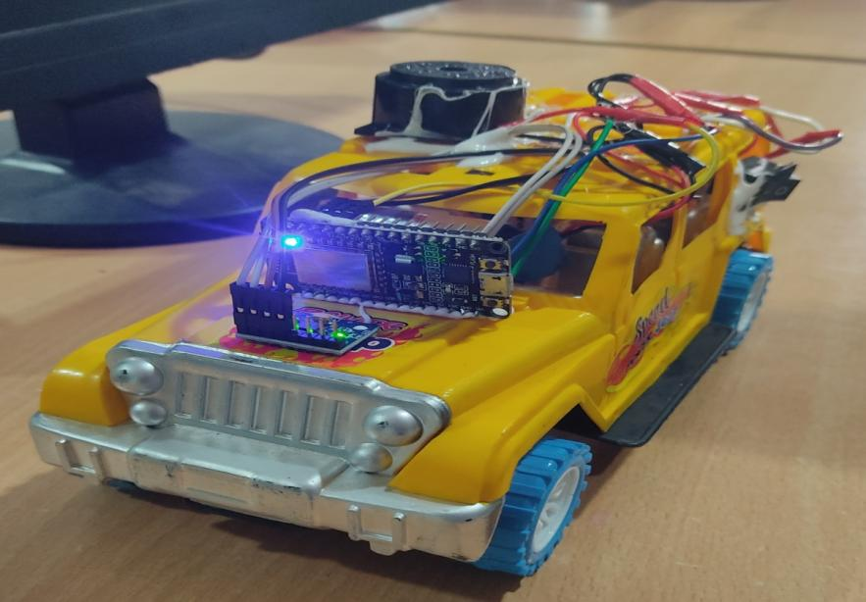
OUTPUT AND RESULTS
Department of Computer Science & Engineering Second Review
Sethu Institute of Technology

Slide 19
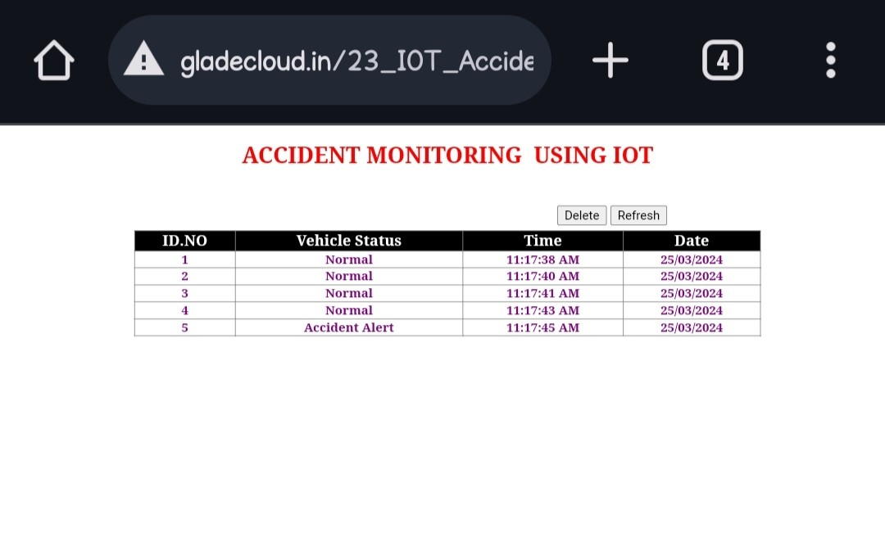
OUTPUT AND RESULTS
Department of Computer Science & Engineering Second Review
Sethu Institute of Technology

Slide 20
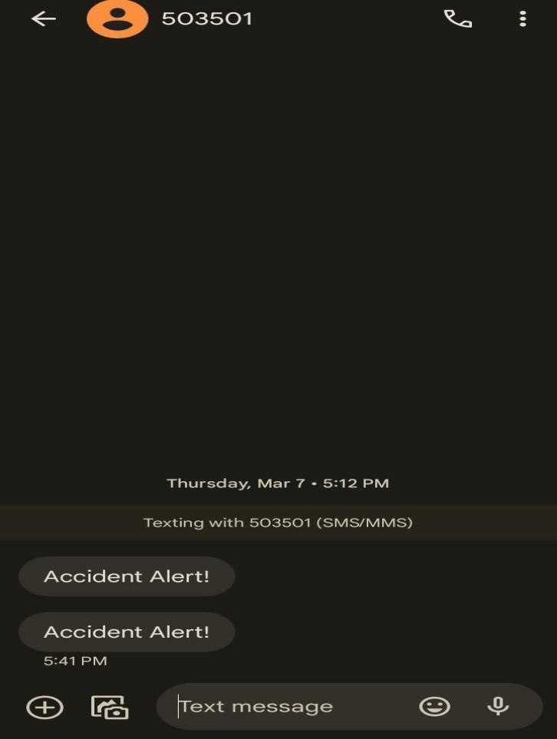
OUTPUT AND RESULTS
Department of Computer Science & Engineering Second Review
Sethu Institute of Technology

Slide 21
REFERENCES
1. Scanlon, J.M., R. Sherony, and H.C. Gabler, Models of driver acceleration behavior prior to real-world intersection crashes. IEEE Transactions on intelligent transportation systems, 2017. 19(3): p. 774-786.
2. Sharma, H., Reddy, R. K., & Karthik, A. (2016, September). S-CarCrash: Real-time crash detection analysis and emergency alert using smartphone. In 2016 International Conference on Connected Vehicles and Expo (ICCVE) (pp. 36-42). IEEE..
3. Ali, H.M. and Z.S. Alwan, Car accident detection and notification system using smartphone. 2017: LAP LAMBERT Academic Publishing Saarbrucken.
4. Roobini, M. S., Mulakalapally, S., Mungamuri, N., Lakshmi, M., Ponraj, A., & Deepa, D. (2020). Car Accident Detection and Notification System Using Smartphone. Journal of Computational and Theoretical Nanoscience, 17(8), 3389-3393.
5. Chen, L. B., Li, H. Y., Chang, W. J., Tang, J. J., & Li, K. S. M. (2015, October). An intelligent vehicular telematics platform for vehicle driving safety supporting system. In 2015 International Conference on Connected Vehicles and Expo (ICCVE) (pp. 210-211). IEEE..
Department of Computer Science & Engineering Second Review
Sethu Institute of Technology

Slide 22
THANK YOU!
Department of Computer Science & Engineering Second Review
Sethu Institute of Technology

